Slide 1
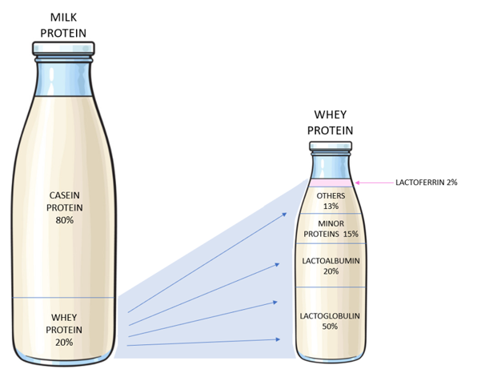
The Proteins in Milk

Slide 2
Lactoferrin and Immunity
An iron-binding glycoprotein. Lactoferrin (Lf) acts as one of the body’s first defense mechanisms against bacterial attack by boosting your immune system with strong anti-microbial, anti-virus, anti-fungal properties
The general immune supporting anti-bacterial and anti-viral properties of Lf have been known for many years. Lf has been shown to inhibit viral impacts on the body through a number of studies
Lf is in all human secretions (tears, saliva) and is in high concentrations in breast milk to support baby’s development and immune system
Markets / Uses
Infant formula
Health supplements
Immune support in medical settings eg cancer treatment
Nutritional foods
Personal care products
Demand
World demand c. 600Tpa. CAGR has been c.8%pa and expected to continue over time
BFC to sell B2B as an ingredient. Pricing varies on quality, term and market segment
Beston seeking c.70%pa volume sold under long term supply contract.
Lactoferrin - the protector in a modern world - YouTube
Lactoferrin And COVID-19: Previous Evidence And Mechanism Against COVID-19 – YouTube

